Slide 1
Miss Gloria’s Science
Mid-May 2020

Slide 2
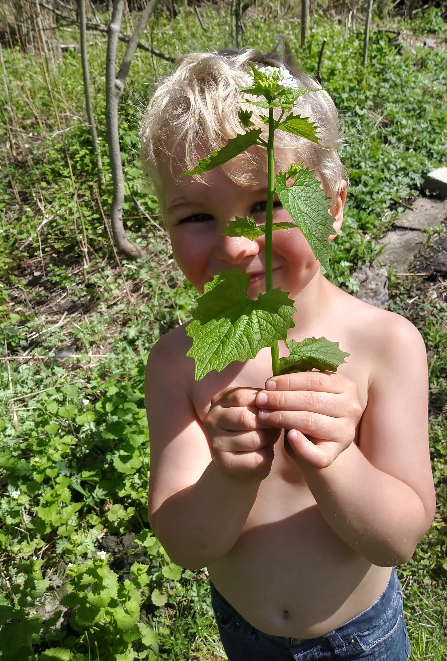
This is Gordon. He wants to learn more about this plant. There seems to be a lot of it around.

Slide 3
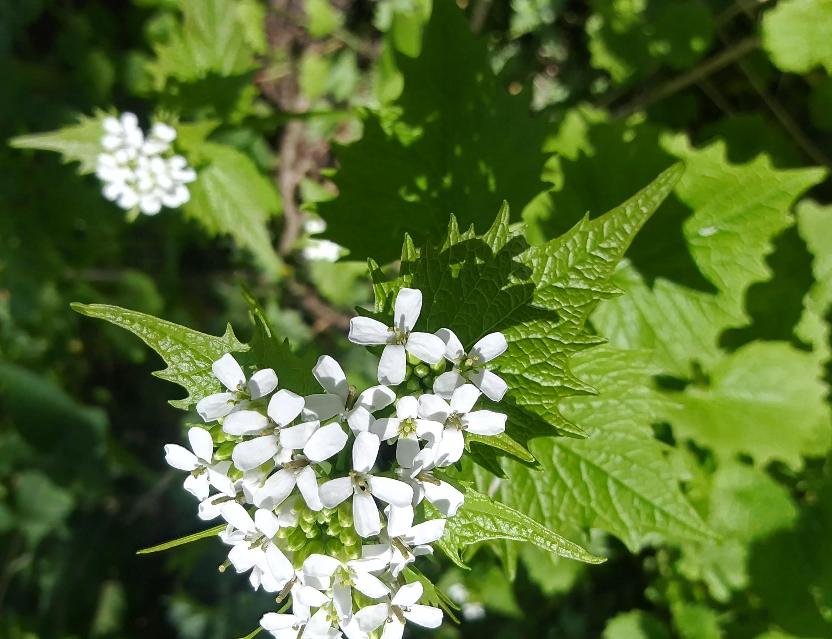
What do you think it is?
Wild carrot
Skunk cabbage
Garlic mustard
Sassafras

Slide 4
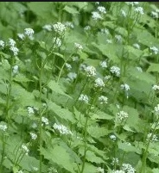
Garlic Mustard
Garlic mustard was first brought to this country by the Europeans for food
It was used as a vegetable and has a lot of vitamins A & C
The roots release a compound that prevents grass and other plants from growing
Garlic mustard is considered an invasive species, it threatens native plants
Each plant can produce 5000 seeds

Slide 5
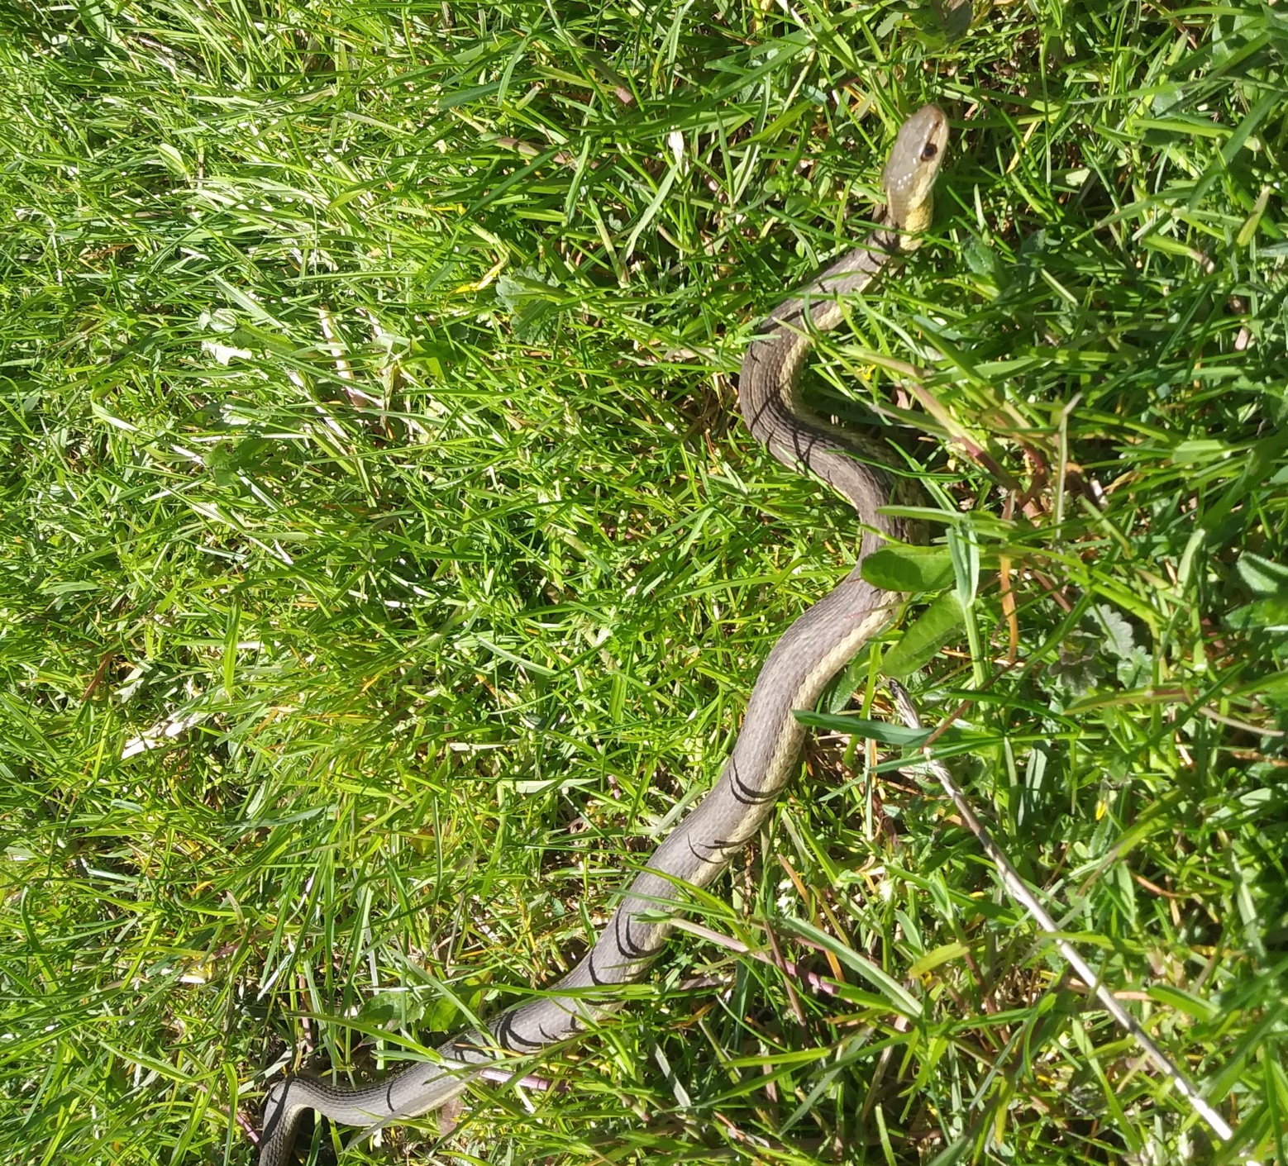
Gordon found this too. What do you think this is?
Loch Ness monster
Rattlesnake
Earth worm
Garter snake

Slide 6
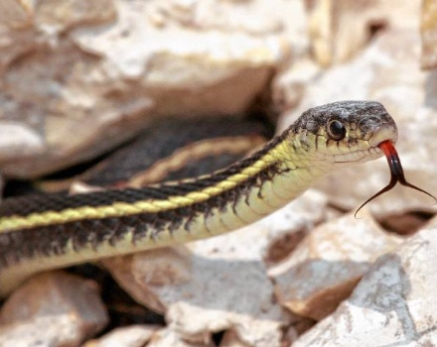
It was a garter snake

Slide 7
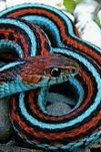
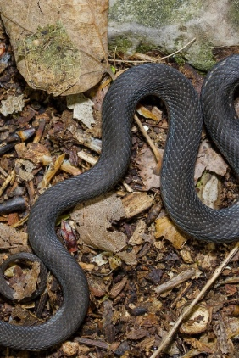
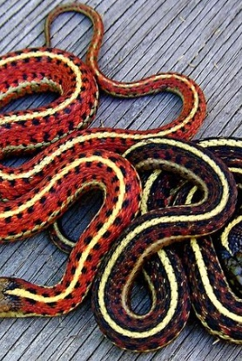
Garter snakes are present throughout North America
They are different colors in different regions

Slide 8
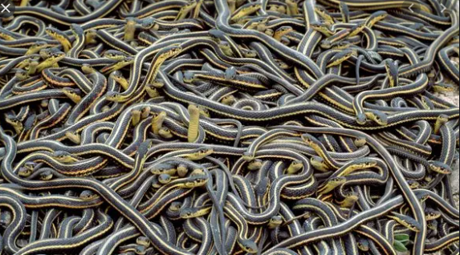
Garter snakes are relatively harmless and some people keep them as pets
The male garter snake can make itself smell like a female and does that to lure males away so it can mate with the female
Females don’t lay eggs but birth as many as 80 little snakes at once, though usually way less
The baby snakes are immediately independent
Garter snakes are very fast and can swim, which makes them good hunters. They eat tadpoles, frogs, small fish, rodents, earthworms and even birds

Slide 9
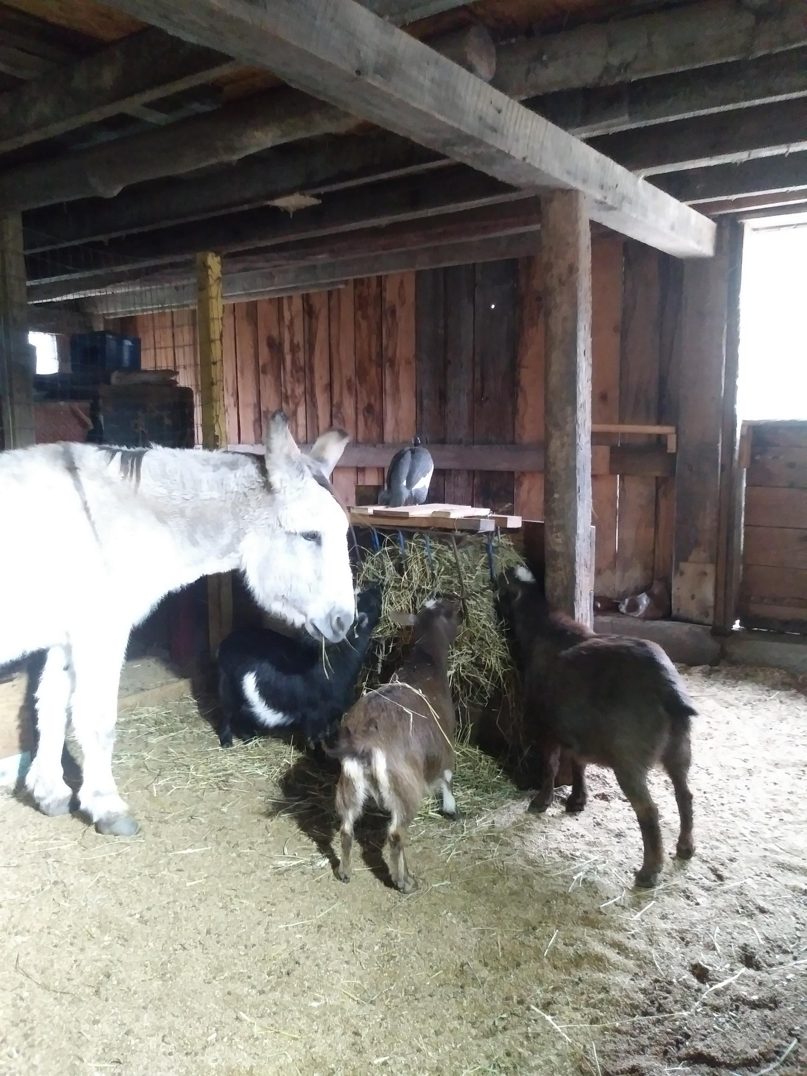
I was getting fresh water for the animals and guess what I found in the bucket
A fish
A tadpole
A salamander
A boot

Slide 10
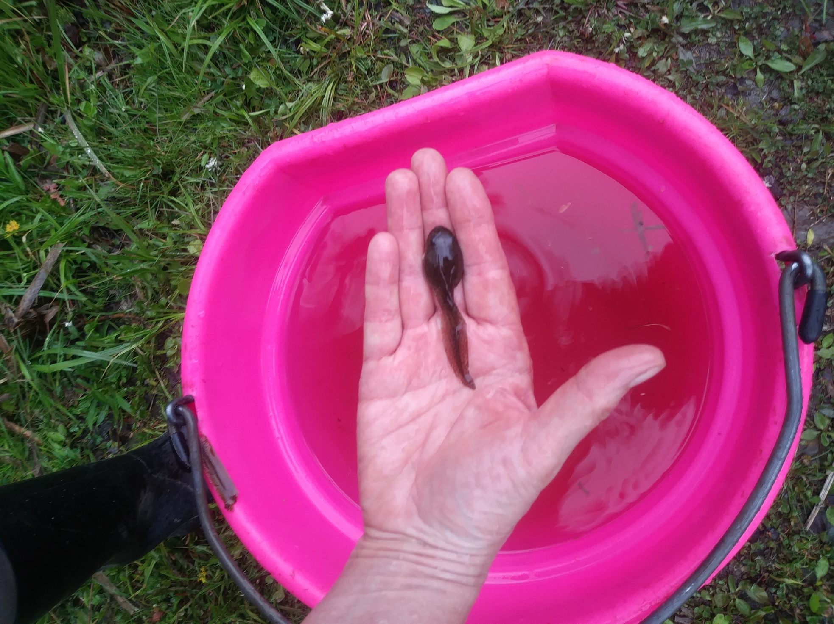
A TADPOLE

Slide 11
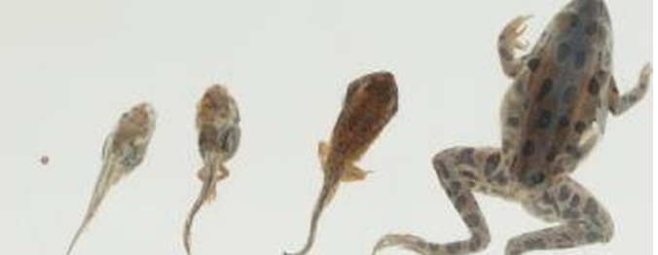
Tadpoles are born with gills, like fish, so they can breathe under water. As they grow they lose their gills and develop lungs.
( I took the tadpole out of the bucket)

Slide 12
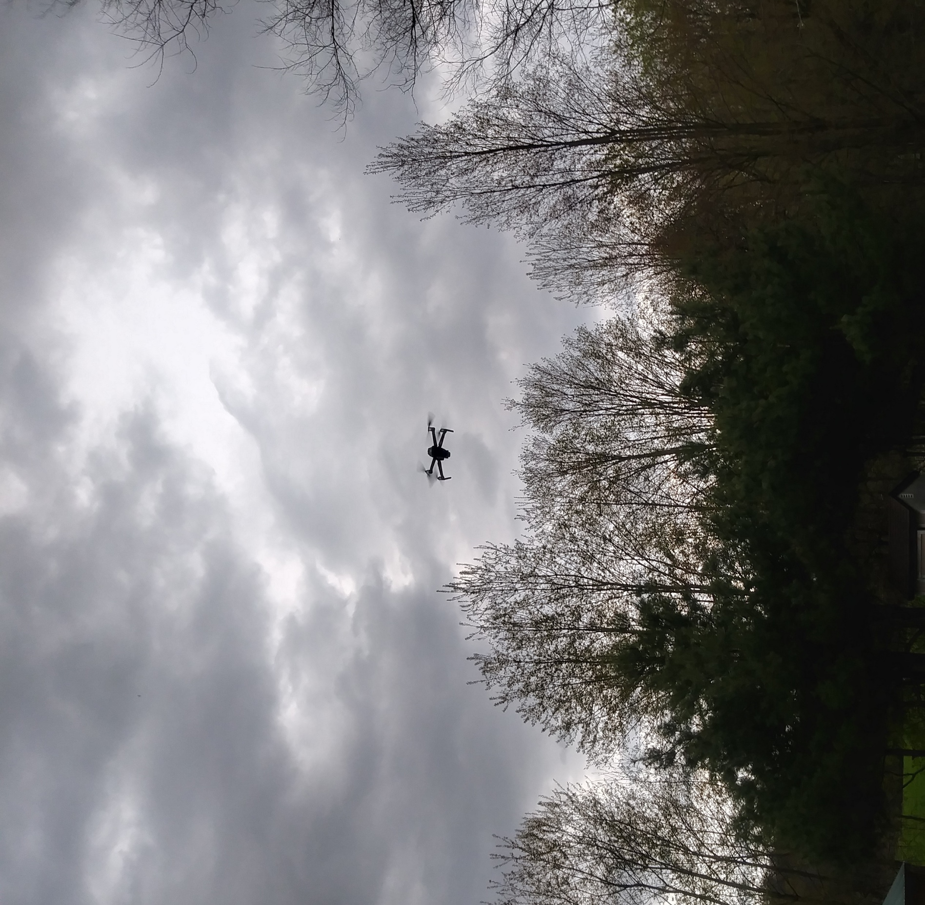
Guess what this is…
A rare butterfly
A dragonfly
A drone
A boomerang

Slide 13
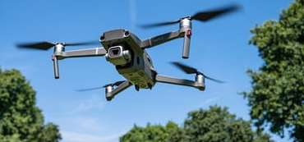
A drone

Slide 14
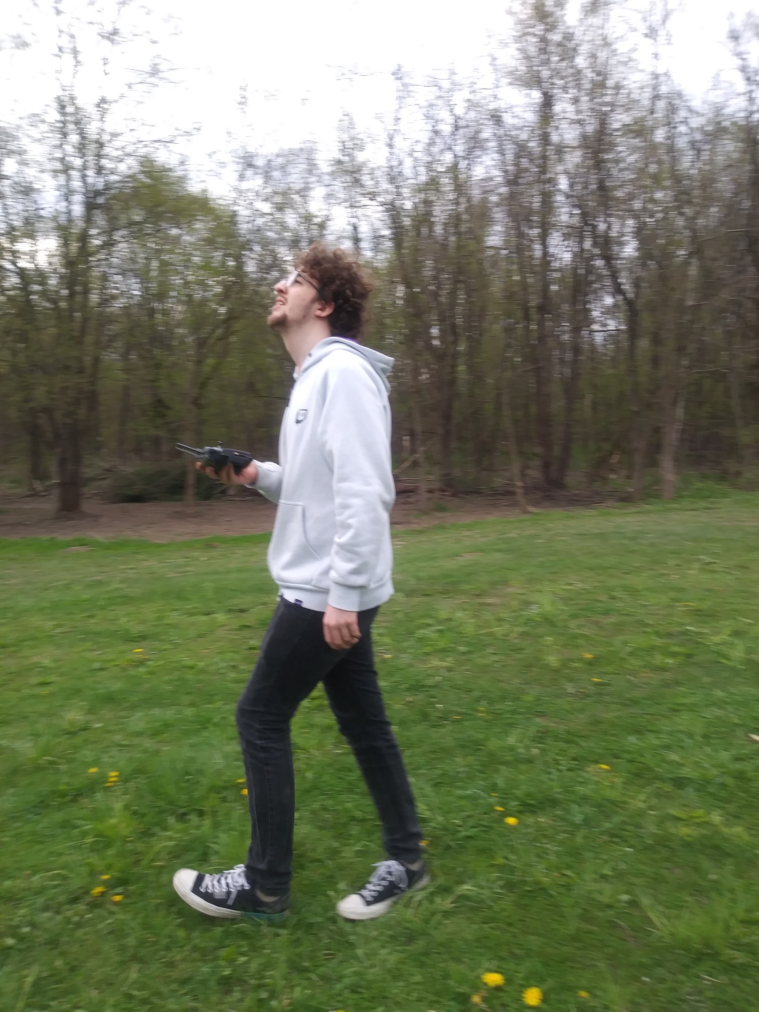
Miss Gloria’s son,
Tristan, flying his drone
The first country to build drones was Israel
In remote areas drones are used to deliver life saving medical equipment and medicines
Drones are being used for food delivery (a special license is needed)
There is a drone racing league (DRL)
It is illegal to fly your drone further than you can see it
In 2015 a drone crashed onto the White House lawn (it was an accident)
A hawk once caught a drone and destroyed it
A Syracuse company is experimenting with using drones for cleaning stadiums

Slide 15
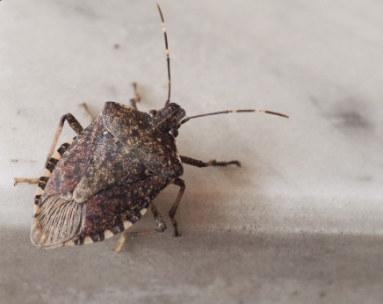
I see lots of these bugs.
Do you know what they are?
Pill bugs
Locusts
Shell flies
Stink bugs

Slide 16
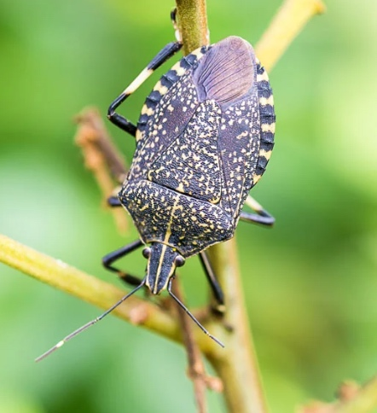
STINK BUGS!
The stink of the stink bug comes from holes in their abdomen
Stink bugs emit an odor when they are squashed or frightened and to attract other stink bugs
Stink bugs like the smell of their stink
There are 2 chemicals that combine to make stink bugs smell like rotting vegetables. they are actually used individually to flavor some foods.
Stink bugs came to the United States in the 1990’s from Southeast Asia (accidentally)

Slide 17
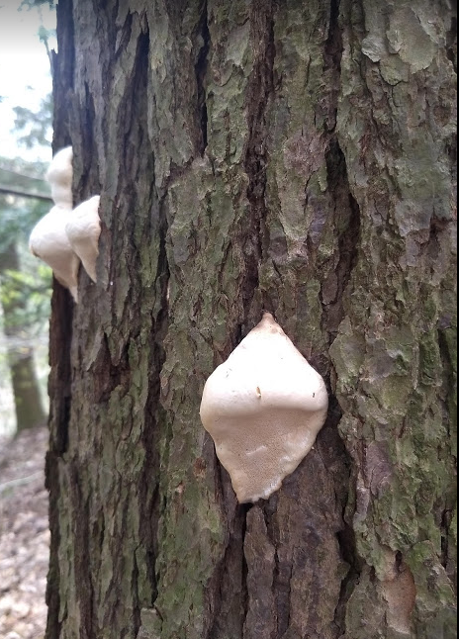
What do you think is on this tree?
Marshmallows
Fungi
Moths
Albino bats

Slide 18
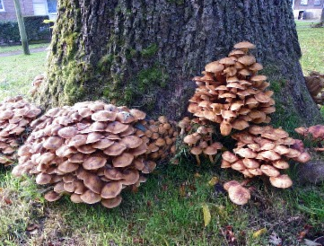
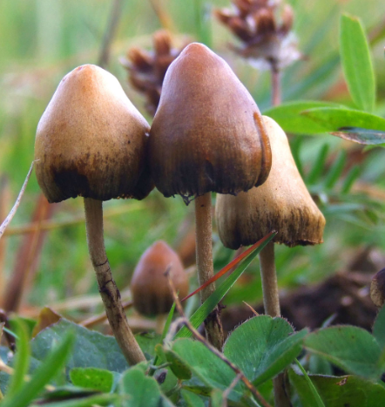
It was tree fungi
Some fungi are harmful to the trees they grow on, some are not
Fungi are their own kingdom, they are not plants, animals or bacteria
Mushrooms are fungi
There are over 100,000 kinds of fungi

Slide 19
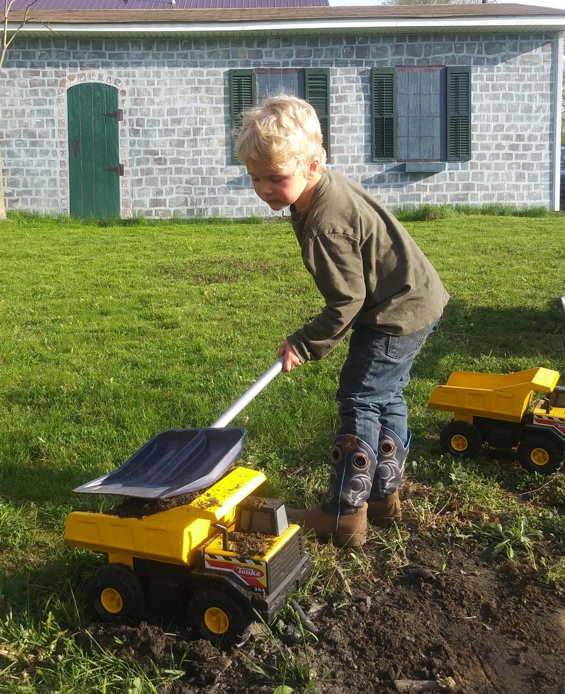
GET OUTSIDE AS MUCH AS YOU CAN, and have fun!
Enjoy the rest of your week and your long weekend

